Slide 1


Drive-through & Field Audit Meeting
February 8th, 2024
For: Stoughton Transportation Task Force
By: Old Colony Planning Council

Slide 2

Agenda
Introduction and Overview
Field Audit
  Review corridor exiting inventory, layout, intersections geometry, traffic flow
  Identify deficiencies, issues and problems
  Gather information for the future land development, transportation improvement plans
  Review communities’ needs

Slide 3
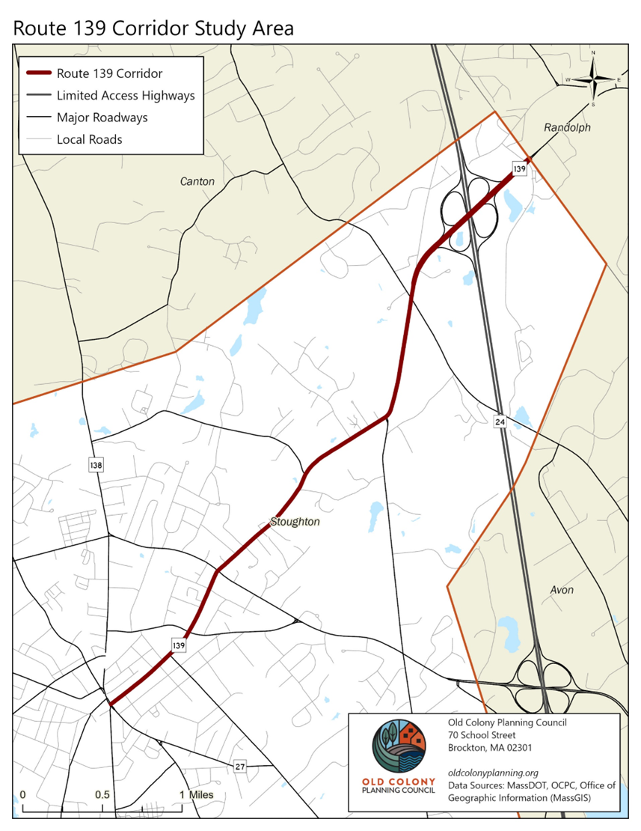
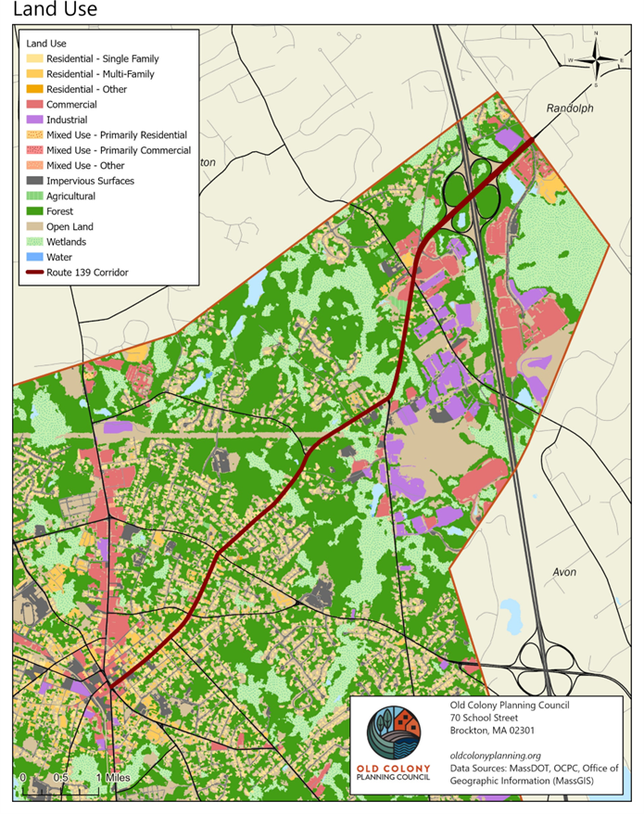
Audit Area

Slide 4
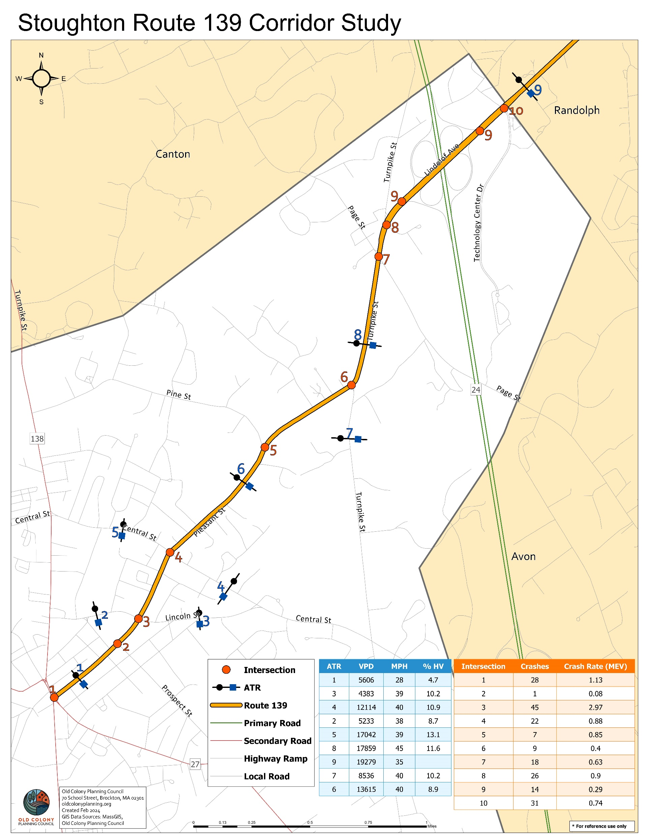
Intersections
Pleasant Street (Route 139) & Washington Street (Route 138) / Park Street (Route 27)
Pleasant Street (Route 139) & Prospect Street
Pleasant Street (Route 139) & Lincoln Street
Pleasant Street (Route 139) & Central Street
Pleasant Street (Route 139) & Pine Street
Pleasant Street (Route 139) & Turnpike Street
Turnpike Street (Route 139) & Page Street
Turnpike Street (Route 139) & Hawes Way
Lindelof Avenue (Route 139) & Route 24 On/Off Ramps
Lindelof Avenue (Route 139) & Technology Center Drive / Kay Way
Mid-block Locations
Washington Street (Route 138), north of Pleasant Street (Route 139)
Washington Street (Route 138), south of Pleasant Street (Route 139)
Park Street (Route 27), south of Pleasant Street (Route 139)
Pleasant Street (Route 139), east of Washington Street (Route 138)
Pleasant Street (Route 139), north of Lincoln Street
Lincoln Street, west of Pleasant Street (Route 139)
Lincoln Street, east of Pleasant Street (Route 139)
Pleasant Street (Route 139), north of Central Street
Central Street, west of Pleasant Street (Route 139)
Central Street, east of Pleasant Street (Route 139)
Pleasant Street (Route 139), north of Pine Street
Pine Street, west of Pleasant Street (Route 139)
Turnpike Street (Route 139), north of Pleasant Street (Route 139)
Turnpike Street, south of Pleasant Street (Route 139)
Page Street, west of Turnpike Street (Route 139)
Page Street, east of Turnpike Street (Route 139)
Lindelof Avenue (Route 139), north of Page Street
Hawes Way, east of Lindelof Avenue (Route 139)
Turnpike Street, west of Lindelof Avenue (Route 139)
Lindelof Avenue (Route 139), over Route 24
Kay Way, north of Lindelof Avenue (Route 139)
Technology Center Drive, south of Lindelof Avenue (Route 139)
Mazzeo Drive (Route 139), east of Technology Center Drive

Slide 5

Current MassDOT Project: Turnpike Street Project #607214
Project Type Hwy Reconstruction - Restoration and Rehabilitation (3R Project)
PRC Approved Date 7/25/2012
Design Status 75% Design
Work on this project consists of roadway reconstruction on Turnpike Street in the Town of Stoughton. The project limits are from Pleasant Street Northerly for approximately 1000 feet. This project is intended to provide a permanent solution to the historical problem of roadway settlement caused by of a vast depth of decomposing subsurface material (peat) which over time has compromised the structural stability of the roadway surface of this targeted segment of Turnpike Street.
Estimated Total Contract Cost $41,007,661.99

Slide 6
Project Development Timeline (updated)

Slide 7

Questions
Contact
Guoqiang Li, PTP, RSP1
Principal Transportation Planner
Project Manager
E-mail Address: gli@ocpcrpa.org
Phone Number: 774-539-5149
Mailing Address: 70 School Street, Brockton, MA 02301
Visit OCPC Website: www. oldcolonyplanning.org

