Slide 1
OCPC
GRANT LOGY
Navigating the World of Funding
SESSION 3: AUGUST 3, 2024

Slide 2
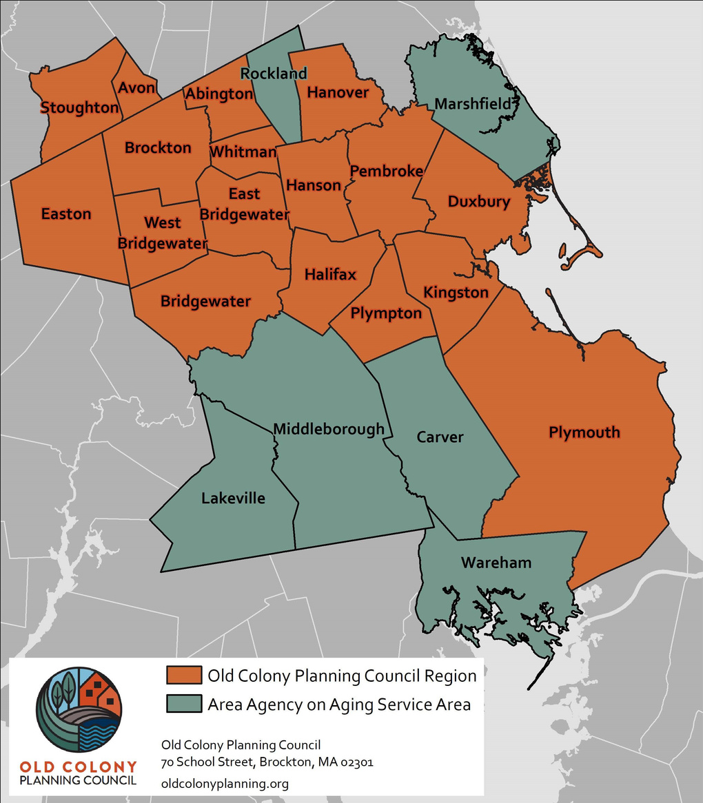
PURPOSE
Paul Umano, Senior Grants Development Specialist OCPC, newly hired to assist our 17 and cities and towns identify grant opportunities in addition to educating and assisting these communities to make informed decisions about applying to federal, state, and foundational grant opportunities.
IDENTIFY
EDUCATE
ASSIST

Slide 3
Access to Updates
MONTHLY WEBINAR SERIES:
Identifies upcoming grant opportunities and provides helpful tips for communities to make informed decisions.
WEBSITE:
www.OldColonyPlanning.org/resources/grant
BI-WEEKLY NEWSLETTER:
Subscribe on Website!

Slide 4
Grant Cycle
Timeline
Grants Open
Due in Summer
Grants Open
Due in Winter
WE ARE HERE
Spring
Fall
Summer
Winter
Grants Open
Due in Fall
Grants Open
Due in Spring

Slide 5
Safe Streets and Roads for All
(SS4A)
AMOUNT: $10 Million max. (Planning & Demonstration Grants
$25 Million max. (Implementation Award)
DEADLINE: August 29, 2024
20% Non-Federal Match - In Kind & Cash Contributions
Awarded on a competitive basis, SS4A supports planning infrastructure, behavioral, operational initiatives to prevent death and series injuries on roads and streets involving all roadway users, including pedestrians, bicyclists, public transportation, motorists and commercial vehicle operators.
There are three program tracts:
Planning Grants, Demonstration Grants, and Implementation Grants.
Before an applicant can apply for an implementation grant, they must have an approved Safety Action Plan.
Notes:
Safe Streets and Roads for All (SS4A) Grant Program | US Department of Transportation

Slide 6
Community Change Grants Program
AMOUNT: $10 - $20 Million: Track I
$1 - $3 Million: Track II
DEADLINE: November 21, 2024
Provides funds in environmental and climate justice activities to benefit disadvantaged communities through projects that reduce pollution, increase community climate resilience, and build community capacity to address environmental and climate justice challenges.
Track I: Community-Driven Investments for Change
Increase community resilience through climate action activities
Reduce local pollution to improve public health
Center meaningful community engagement
Build community strength
Reach priority populations
Maximize integration across projects
Track II: Meaningful Engagement for Equitable Governance
For facilitating engagement of disadvantaged communities in State and Federal public processes.

Slide 7
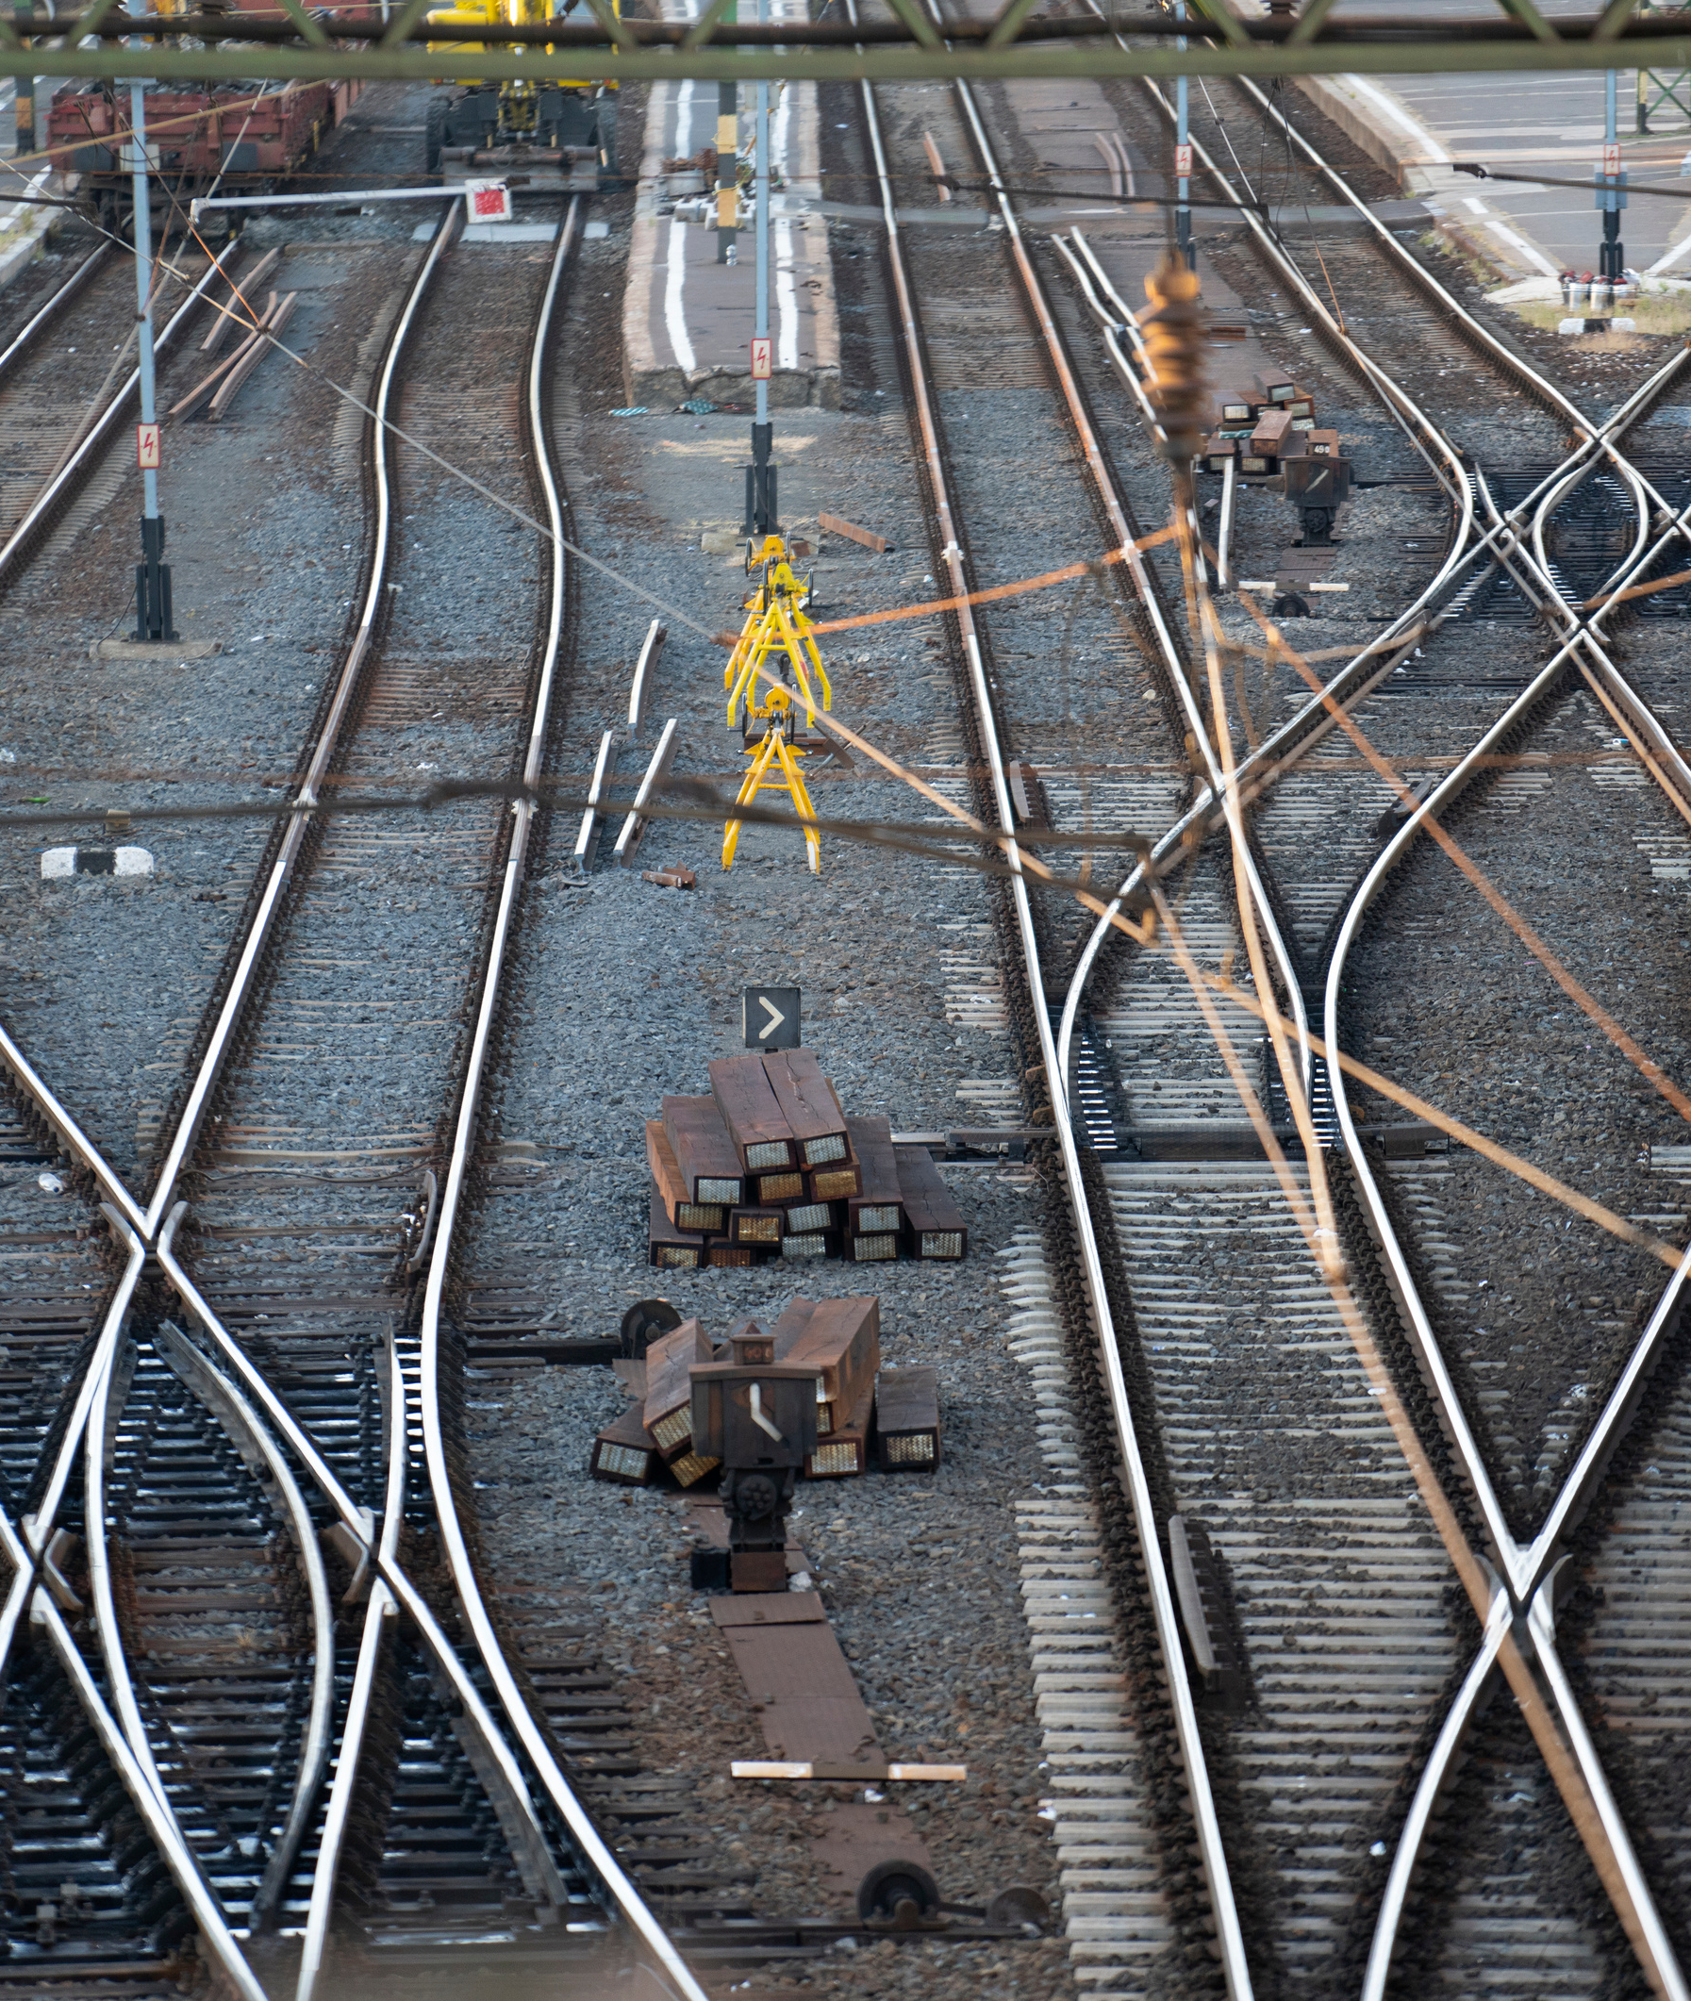
Strengthening Mobility and Revolutionizing Technology (SMART) Stage 2
AMOUNT: $2 - $15 Million
DEADLINE: August 14, 2024
Applicants under the Stage 1: Planning and Prototyping Grants focus on pilot projects that focus on using technology interventions to solve real-world challenges and build data and technology capacity and expertise in the public sector.
Stage 2 implementation projects should result in a scaled-up demonstration of the concept, integrating it with an existing transportation system, and refining the concept such that it could be replicated by others.

Slide 8
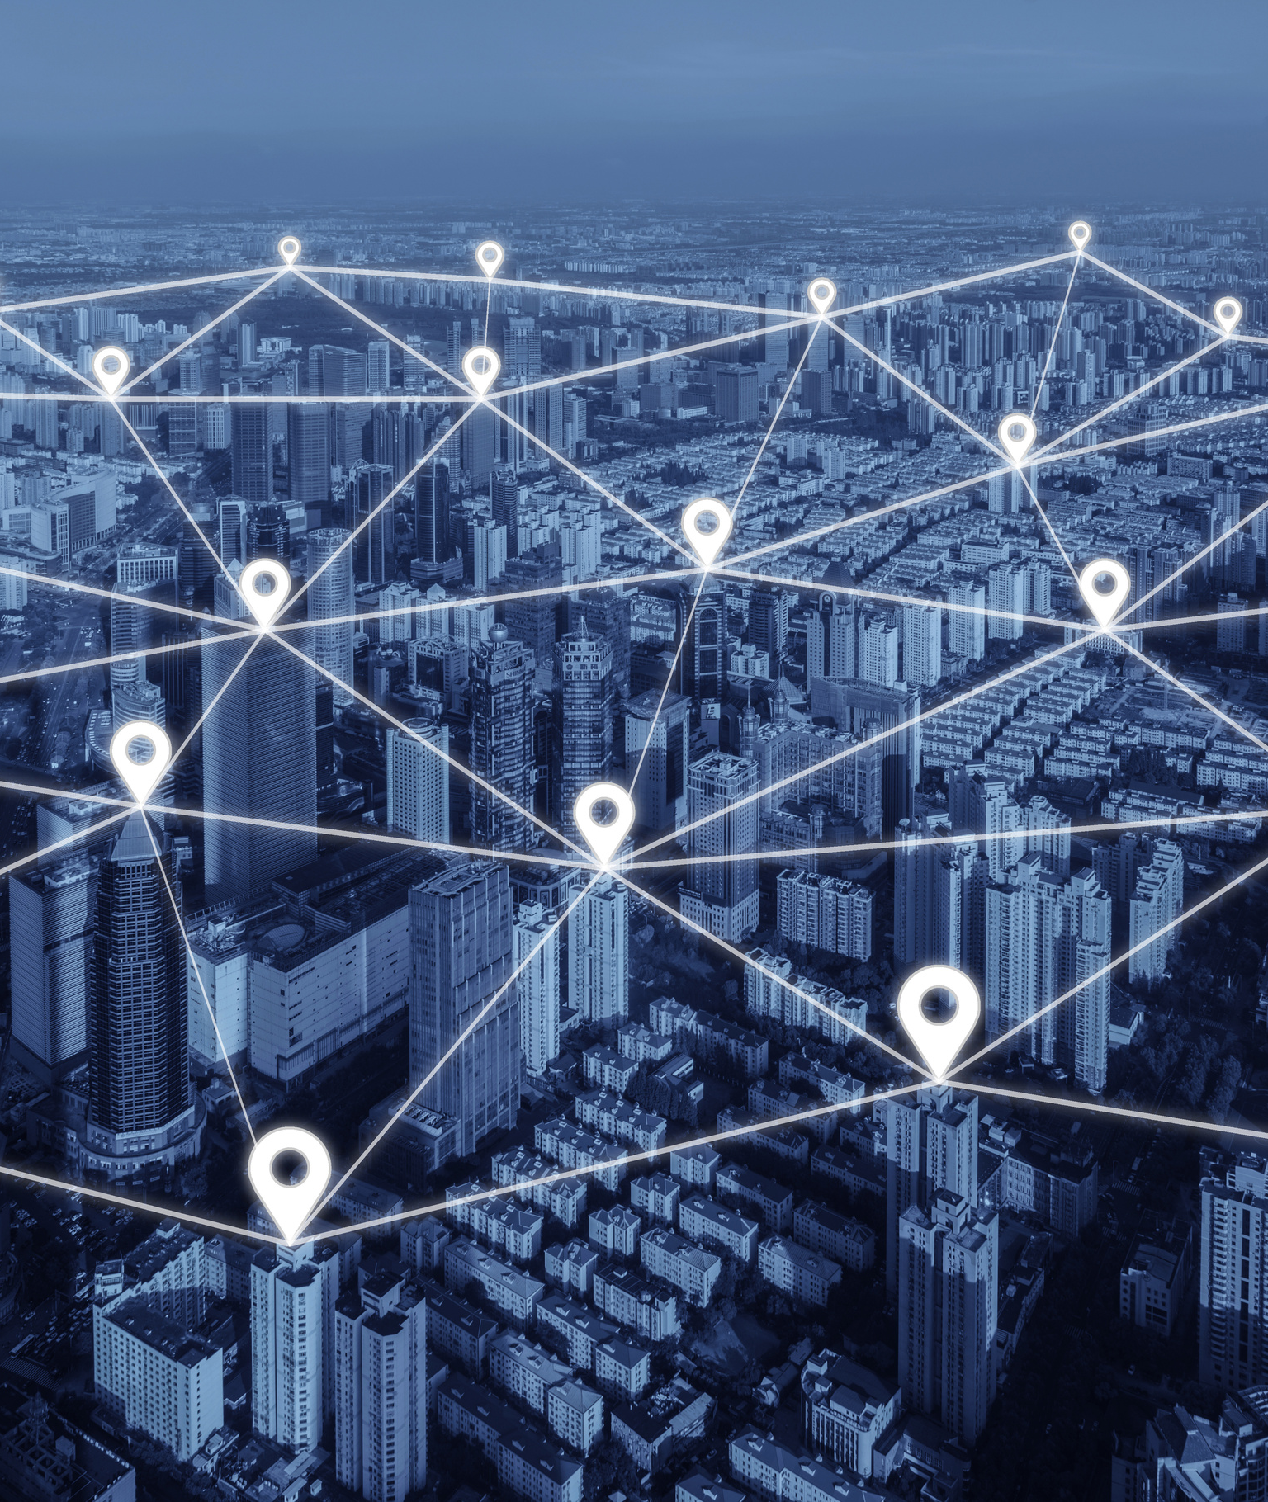
Reconnecting Communities Pilot (RCP)
AMOUNT: $2 Million, 20% Match: Planning Grant
$5 - $100 Million, 50% Match: Construction Grant
DEADLINE: September 30, 2024
The RCP is awarded to projects that reconnect communities by removing, retrofitting, or mitigating highways or other transportation facilities that create barriers to community connectivity, including mobility, access, or economic development.
Planning Grants- fund the study of removing, retrofitting, or mitigating an existing facility to restore community connectivity; public engagement; and other transportation planning activities.
Capital Construction- fund a project to remove, retrofit, mitigate or to replace an existing eligible facility with a new one that reconnects communities.

Slide 9
US DOT NAVIGATOR
STATE TRANSPORTATION GRANTS DASHBOARD
KEY NOTICES OF FUNDING OPPORTUNITY | US DOT
Available Resources
AMPO NOFO TRACKER
FEDERAL FUNDS INFORMATION FOR LOCAL GOVERNMENTS | MASS.GOV
LOCAL INFRASTRUCTURE HUB - NATIONAL LEAGUE OF CITIES
US DOT EQUITY ACTION PLAN
BIPARTISAN INFRASTRUCTURE LAW (BIL) LAUNCHPAD

Slide 10
Visit the Grantology Website:
https://oldcolonyplanning.org/grantology/

Slide 11
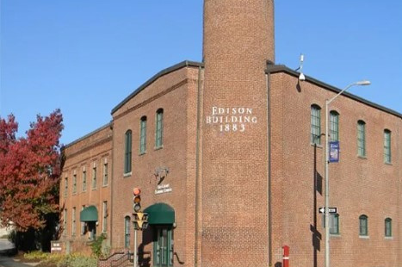
OCPC
GRANT LOGY
Get in Touch
Navigating the World of Funding
Contact us to get more info
pumano@ocpcrpa.org
70 School Street, Brockton, MA 02301
774-539-2251
oldcolonyplanning.org

