Slide 1
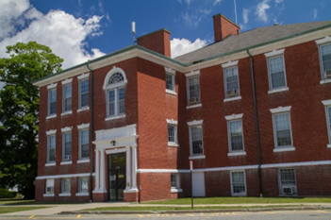
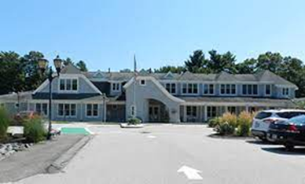
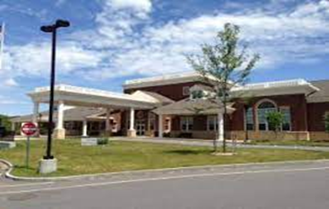
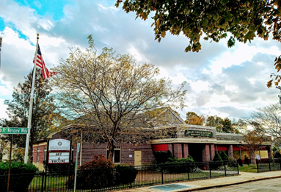
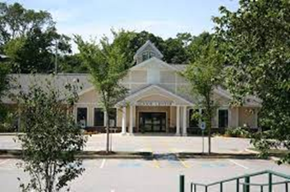
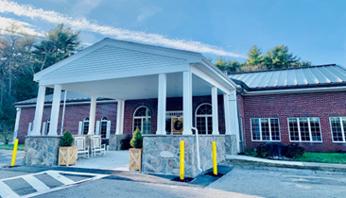



ELDER MENTAL HEALTH MSW INTEGRATED INTERNSHIP PROGRAM

Slide 2
MEMBERS OF THE SOUTH SHORE ELDER MENTAL HEALTH CONSORTIUM
Joanne Moore, Council on Aging Director – Duxbury, MA
Michelle Bratti, Commissioner of Health & Human Svc - Plymouth, MA
David Klein, Administrator Old Colony Planning Council – Area Agency on Aging
Other Community Partners: Bridgewater State University, etc.
PRESENTED & FUNDED BY:

Slide 3
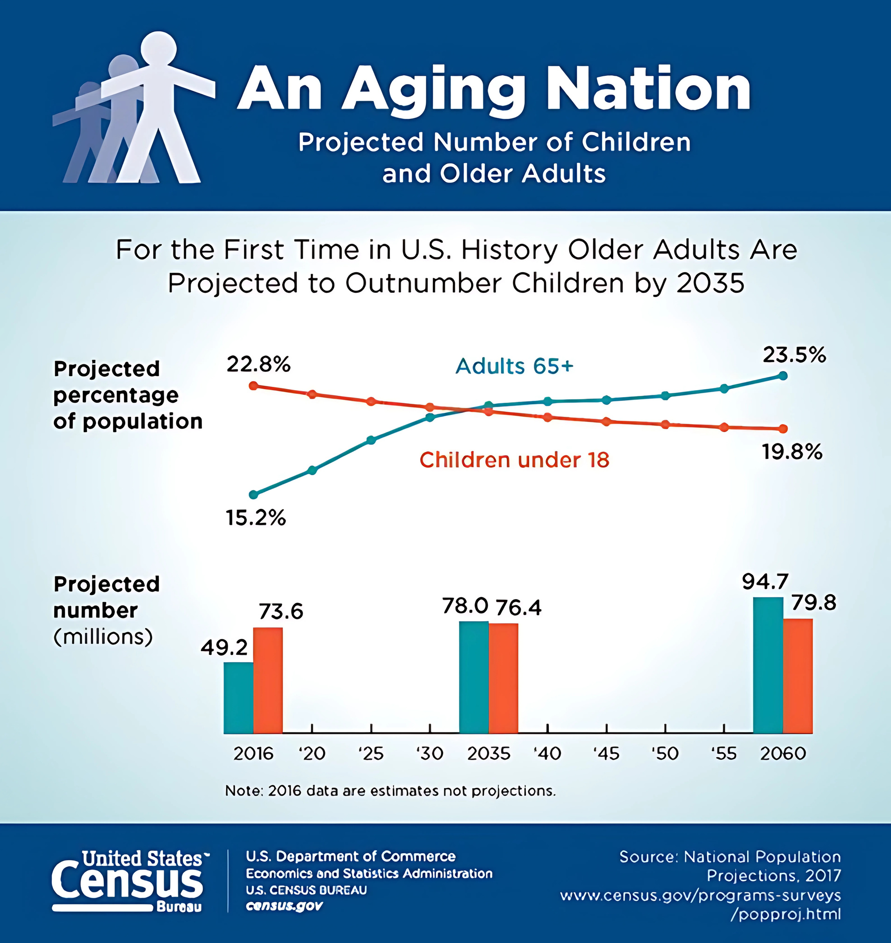
GROWTH IN THE U.S.

Slide 4

AGING
NOT THIS:
BUT THIS!
Dependency
Loss
Weakness
Isolation
Contribution
Growth
Flexibility
Connection

Slide 5
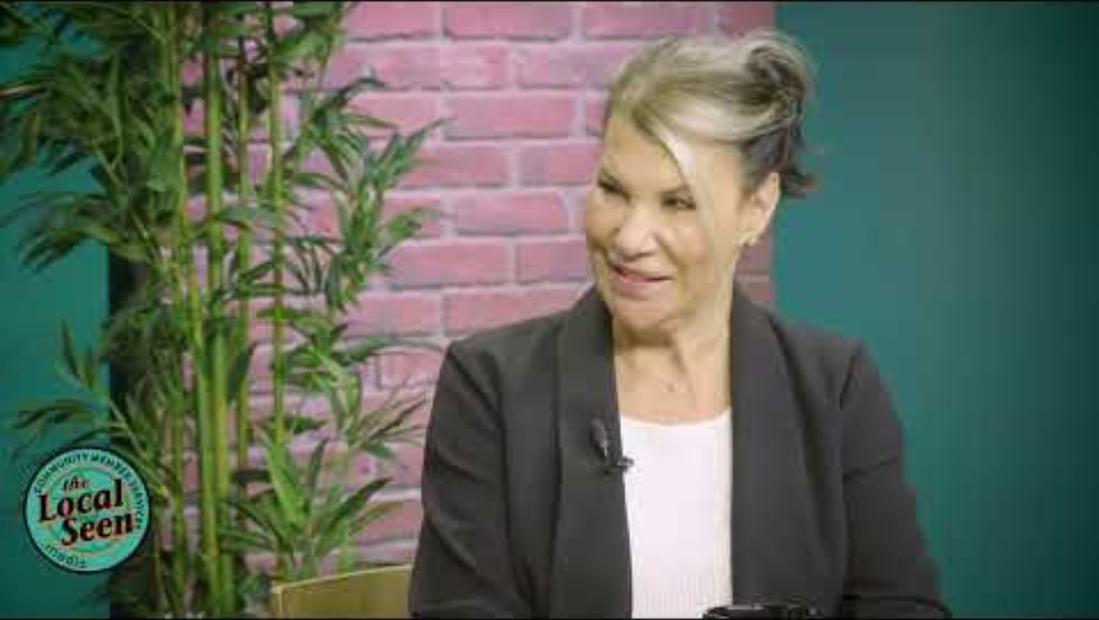

Slide 6
DEVELOPMENT HISTORY OF THE SSEMHC
ELDER MENTAL HEALTH INTERNSHIP PROGRAM
AREA AGENCIES ON AGING
LOCAL COLLEGES/ UNIVERSITIES
COUNCILS ON AGING
COMMUNITY PARTNERS
ALL HANDS-ON DECK APPROACH!

Slide 7




BASIC FACTS
There are a lot of older people.
There are going to be many more.
The age wave will continue to profoundly change the way society functions.
We need more people in the field.

Slide 8


THE NEED
Older Population - Post COVID/Isolation/Anxiety
Lack of Mental Health Resources
Mental Health Stigma
FACTORS
BARRIERS
Living alone
Having a small social network
Infrequent participation in social activities
How to provide a program to bring connectedness to older adults with mental health services
Money-Funding
Availability/access to professionals
Ability for seniors to see past any negative stereotypes, surroundings mental or behavioral health services

Slide 9






GOALS IN IMPLEMENTATION
CHALLENGE
When you’ve seen one COA, you’ve seen on COA!
3-TIERED APPROACH TO THE PROGRAM
Provide free mental health services in-house Senior Centers.
Reduce social isolation and loneliness among older adults.
Hire a credentialed supervisor
Reduce stigma by normalizing mental health discussions.
Use trusted
staff to navigate the day-to-day with the intern
Create community connectedness amongst students, COAs, and older adults to support their mental health.
Increase the number of professionals working in the field of aging.
Director needs to make the decision to adapt to be successful and run smoothly.

Slide 10








IMPLEMENTATION GUIDELINES/TIMELINE:
Meet early Spring through Summer with referred MSW students to interview for the upcoming school year (Sept. - May)
Identify point person at each COA who will oversee/work with intern.
Identify MSW programs & funding sources in your region
May/June place interns in COA to begin in September
Generally, the Community Service Manger or Outreach worker.
Partner with the MSW Internship Department for Referral
Identify COAs who are interested in a MSW intern
Spring/early Summer interview MSW students
Marketing & Promotion
Job Description

Slide 11



USES OF FUNDING
PAYMENT
FOR
CLINICAL SUPERVISOR
STIPENDS FOR INTERNS
(during internship or when complete)
PROGRAM INCIDENTALS AND COSTS FOR EACH COA

Slide 12
ROLE OF CLINICAL SUPERVISOR
Supervision for student/intern
LICSW, LCSW or MSW with 2 years of experience (as required by BSU), others may have different qualifications.
Meet 1 hour weekly with each intern for supervision
(can be in person or virtually)
Create Learning Contract (as required by MSW Program) Beginning September and January
Review and comment on Processes Recordings
End of Semester evaluation December/May
Meet with COA intern liaison as needed
Monthly reports to SSEMHC on activities completed as well as sharing anecdotal information or experiences

Slide 13


EXAMPLES OF ACTIVITIES/PROGRAMS PERFORMED BY INTERNS
GROUP PROGRAMMING THAT ADDRESS WELL BEING & ISSUES OF AGING
1:1 MENTAL HEALTH COUNSELING/SUPPORT FOR SENIORS EITHER IN SENIOR CENTER OR AT HOME VISIT
Live Your Life Well Program
Topic based coffee hours - TED Talks with discussions
Lead Writing - expression workshops
Meals on Wheels, Friendly Visitor Participation
Caregiver Support Groups & Grandparents Caring for Grandchildren Activities
Lend Assistance with Adult Day Program
Participate in Bereavement Support Groups & include Local Hospice
Through Warm Handoff/Referral from Outreach Coordinator

Slide 14

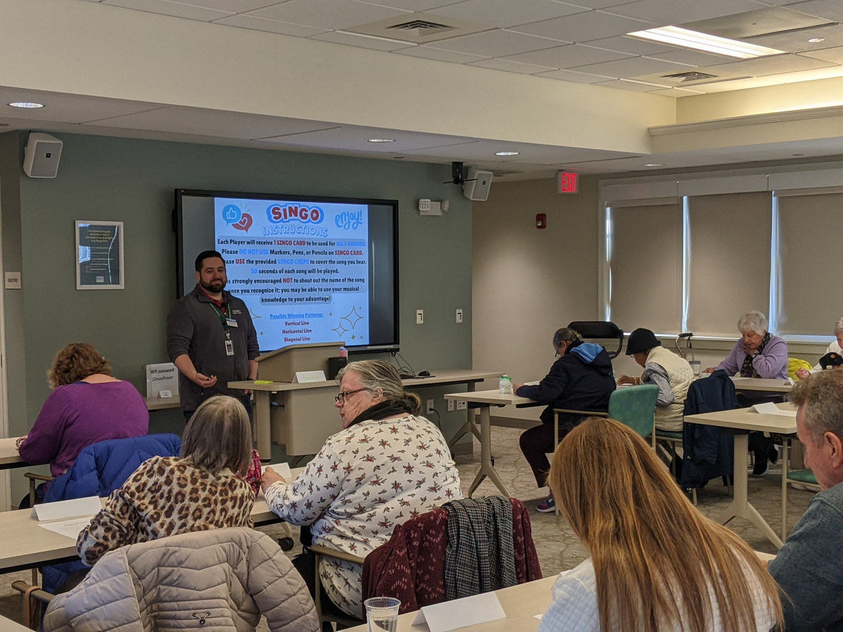
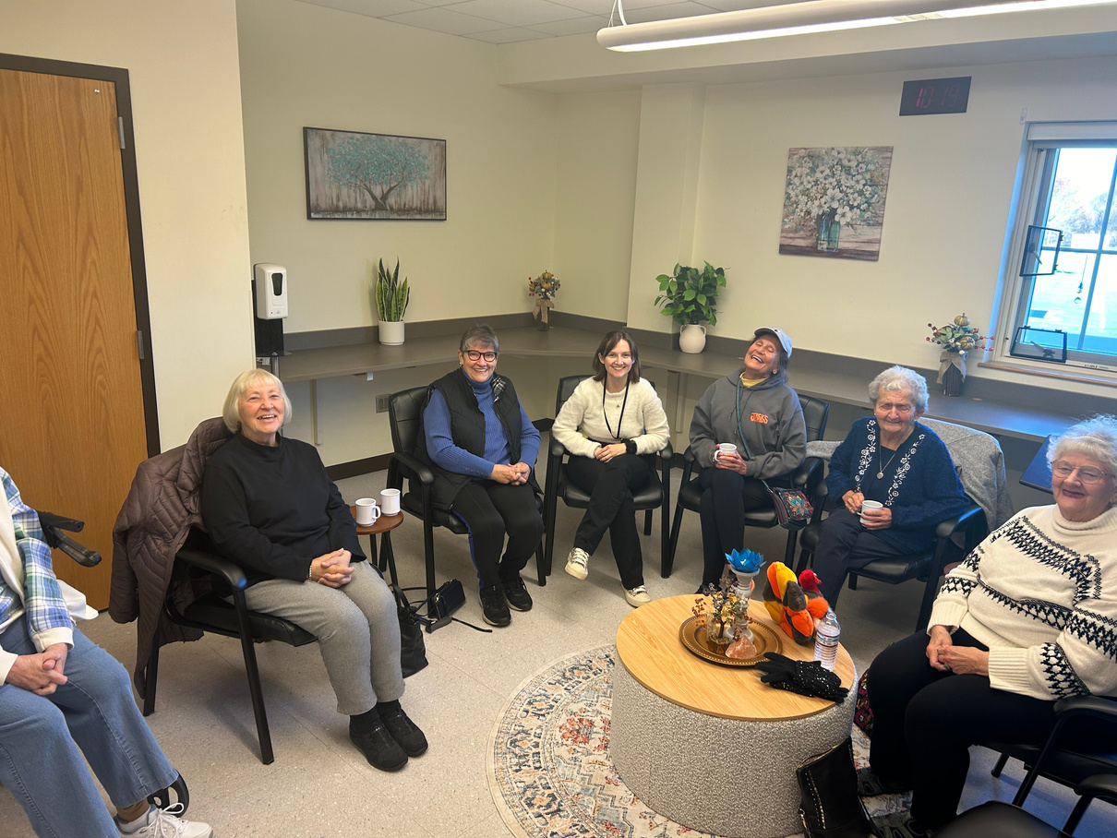

NEWSLETTER & INTERNAL COMMUNICATIONS
REGARDING MSW INTERN - ACTIVITIES, PROGRAMS & SERVICES

Slide 15

AN INTERN RUN PROJECT
10 TOOLS OF RESILIENCY
Connect with Others
Stay Positive
Get Physically Active
Help Others
Deal Better with Hard Times
Create Joy & Satisfaction
Eat Well
Take Care of Your Spirit
Get Enough Sleep
Get Professional Help if you Need It

Slide 16
PAYOFF:
BY THE NUMBERS:
OUR MSW INTERNS TRACKED THE PROVISION AND/OR FACILITATION OF THE FOLLOWING:
Tracked Activities & Benefits for Older Adults, including:
12
8
Community Outreach external
to COA
47
Intern Activities, Events & Programs Attended
Counseling
Communication
Advocacy
Activity
Group Counseling Sessions Facilitated
72
Individual Counseling Sessions Provided
93
Email Advocacy to providers, staff, and clients for resources and appointments
156
Phone Call Advocacy to providers, staff & clients for resources and appointments
Participants of the Group Counseling Sessions
104

Slide 17




FUNDING & DOCUMENTATION
How to get the funding
Example: Title III grants from the Older Americans Act
Documentation and statistics
Centralized Partnerships
Flow of money through one COA in the region
Example: Duxbury COA receives all money from OCPC for:
Payment for Clinical Supervisor
Stipends for interns (during internship or when completed)
Program incidentals and costs for each COA

Slide 18

SUCCESSES
Implemented/Enhanced Clinical Mental Health Services
Reduced Loneliness
Improved Senior Wellbeing
Expanded Outreach Services
Increased Professional Interest in the Geriatric Field
CHALLENGES
Reduce Expense Through Regional Collaboration
Bridged Services to Homebound Older Adults
Need a Fiscal Hub
Space
Onboarding
Staffing
Time

Slide 19


HOW CAN YOUR CENTER TAKE ON A PROJECT LIKE THIS?
{
Funding & Resources
Example: Title III grants from the Older Americans Act
Someone regional to assist
Example: AAA or Other Liaisons)
Which Community COAs Want to Participate in a Consortium
IDENTIFY
College/University to Partner with to Provide Student Interns
{
Example: First & Second Year MSW, LMHC
Market the Mental Health Service & Programs to Your Community Partners
COLLABORATE

Slide 20




HOPES FOR THE FUTURE
PRESENT PROJECT NATIONALLY
REPLICATE PROJECT IN ALL COAS
SECURE PERMANENT FUNDING
EXPAND PROFESSIONAL OPPORTUNITIES IN GERONTOLOGY FIELD

Slide 21
THANK YOU
Joanne Moore, Director
Duxbury Council on Aging
781-934-5774 x5700
joannemoore@duxbury-ma.gov
David Klein, Administrator
Old Colony Planning Council
Area Agency on Aging
774-539-5220
dklein@ocpcrpa.org
Michelle Bratti, Commissioner of
Health & Human Services - Plymouth
508-830-4230 x13102
mbratti@plymouth-ma.gov

